Slide 1
Burkina Institute of Technology
GROUP 11
Members of group
THIOMBIANO Abdoul Aziz THIOMBIANO Jeannine DIALLO Djénéba
ZONGO Yacouba
Teachers
Miss Otema YIRENKYI
Miss Kweyakie BLEBO

Slide 2

Student Performance Analysis
An Exploratory Data Analysis Project
This project aims to identify and analyze the primary factors influencing students' academic performance through robust data analysis and visualization. Our goal is to provide data-driven insights for improved educational strategies.

Slide 3

Context & Analytical Questions
Academic performance is a complex outcome shaped by both educational interventions and socio-economic realities.
1
2
Test Preparation Efficacy
Does structured test preparation significantly improve student performance across subjects?
Socio-Economic Impact
How do various socio-economic factors influence academic outcomes?
3
Gender-Based Disparities
Are there notable performance differences between genders in academic results?

Slide 4


Dataset Overview
Analytical Focus
Our analysis centers on evaluating global performance by introducing an "Average Score" metric, derived from the mean of the three core subject scores. This holistic approach provides a clearer picture of overall academic standing.
Dataset Content
Scores in Mathematics, Reading, and Writing
Comprehensive student demographic variables
Key socio-economic indicators

Slide 5
Data Preparation
Data Quality Assessment
No missing values detected, ensuring data completeness.
No inconsistent entries identified, affirming data reliability.

Slide 6
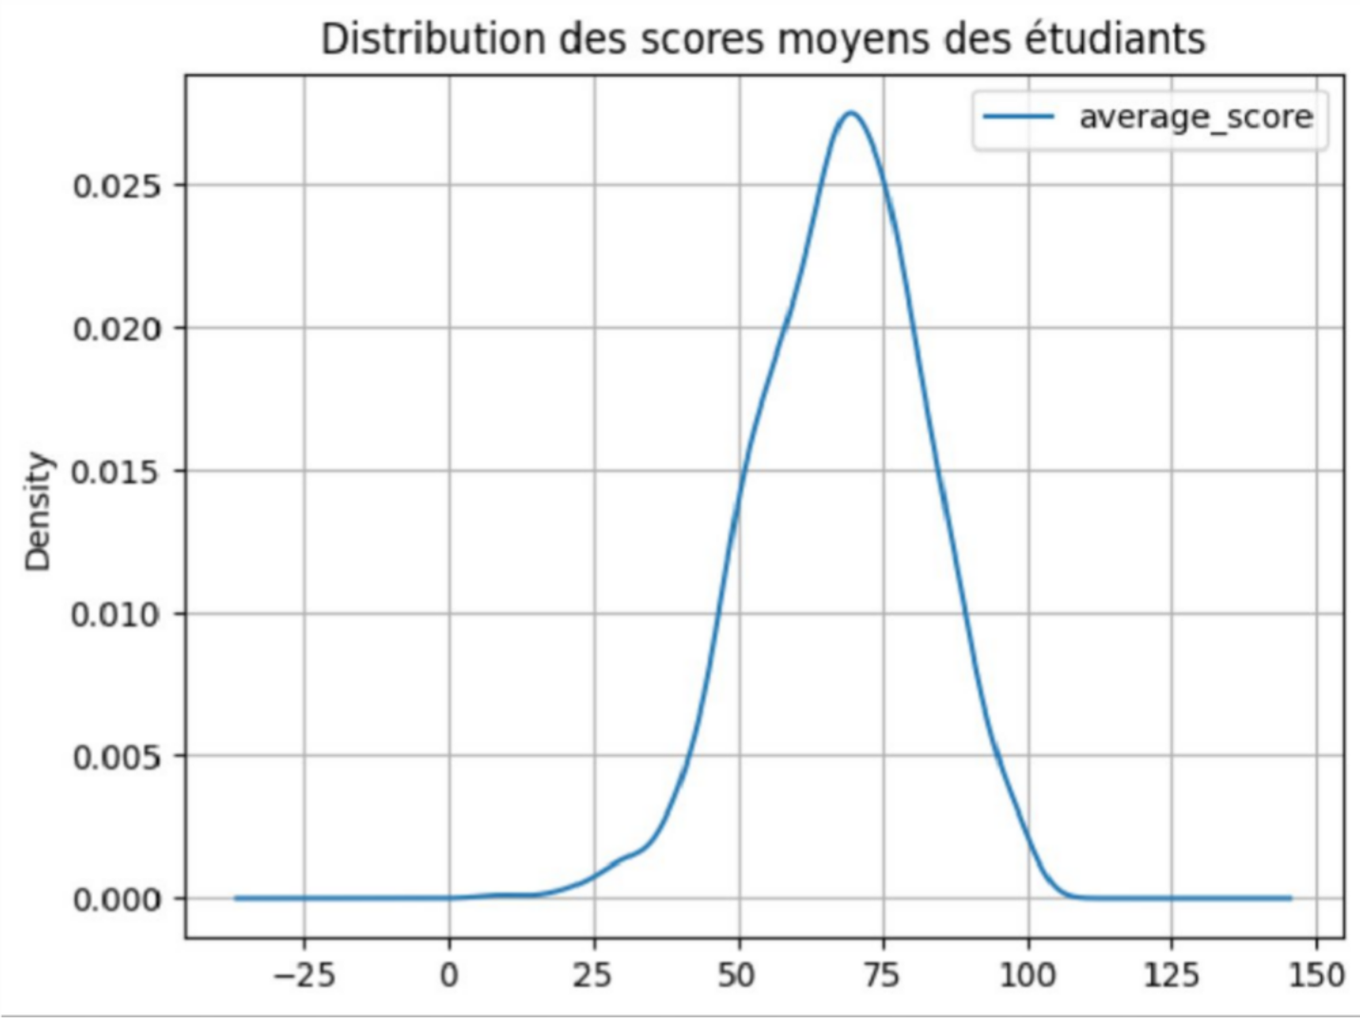
Distribution of Academic Scores
The distribution of academic scores reveals a balanced spread, with a distinct concentration of students achieving average values. This pattern indicates overall stability in academic performance across the dataset, suggesting a healthy learning environment without extreme score deviations.

Slide 7

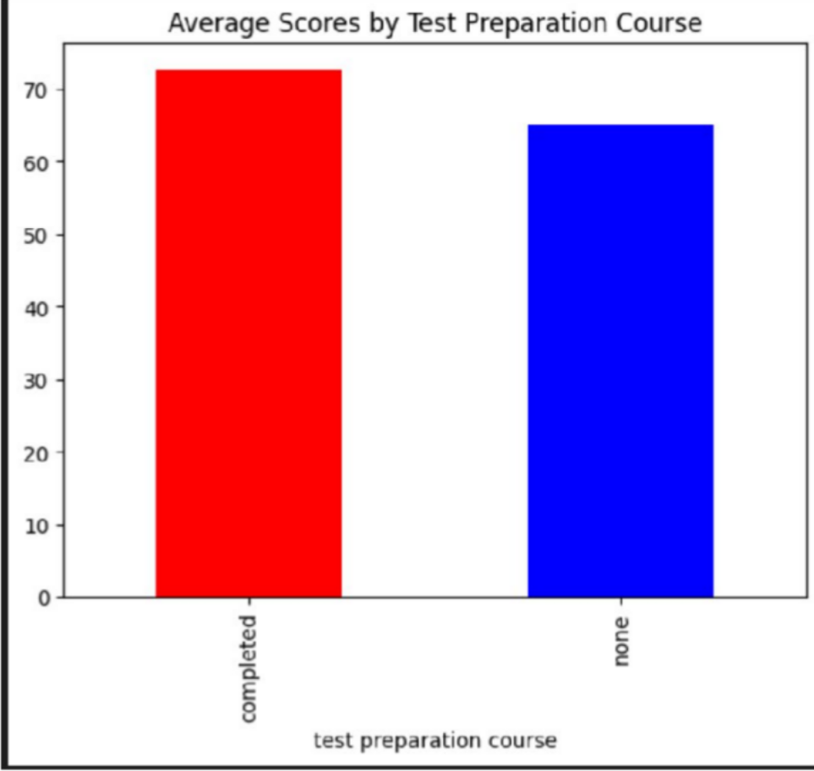
Impact of Test Preparation Courses
Students who engaged in test preparation courses consistently demonstrated significantly higher average scores. This highlights the substantial positive influence of structured preparation on academic outcomes, suggesting these programs equip students with effective strategies and knowledge.

Slide 8
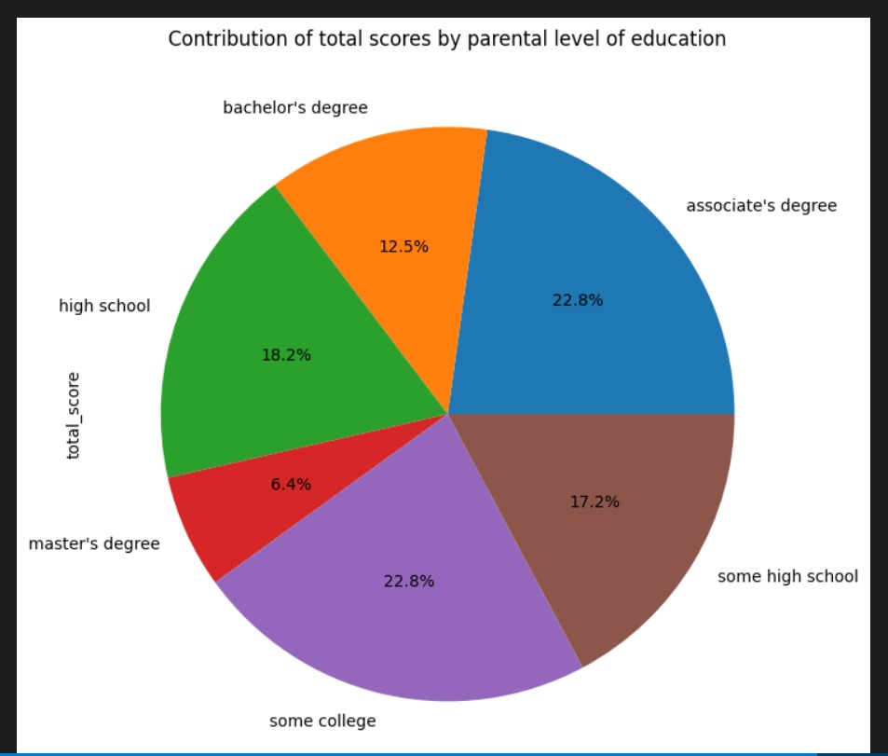
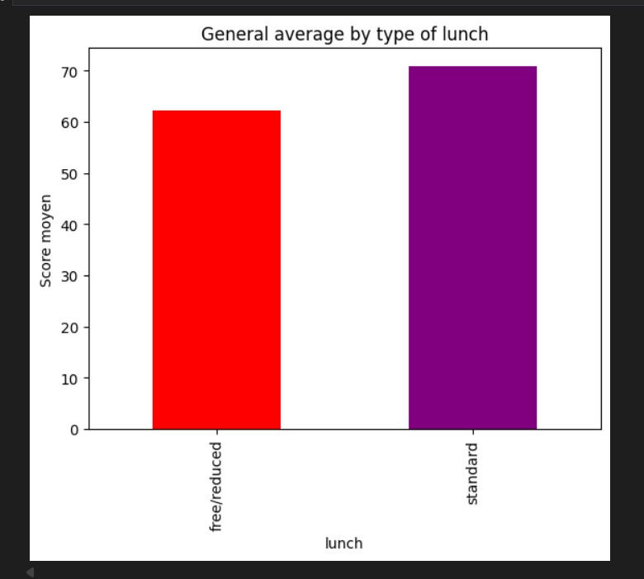
Socio-Economic Factors and Performance
1 2
Parental Education
Higher parental education is associated with a greater share of student performance.
Lunch Type
Students with standard lunch perform better than those with free/reduced lunch.
Overall, socio-economic factors appear to be associated with academic performance, highlighting observable disparities between student groups.

Slide 9

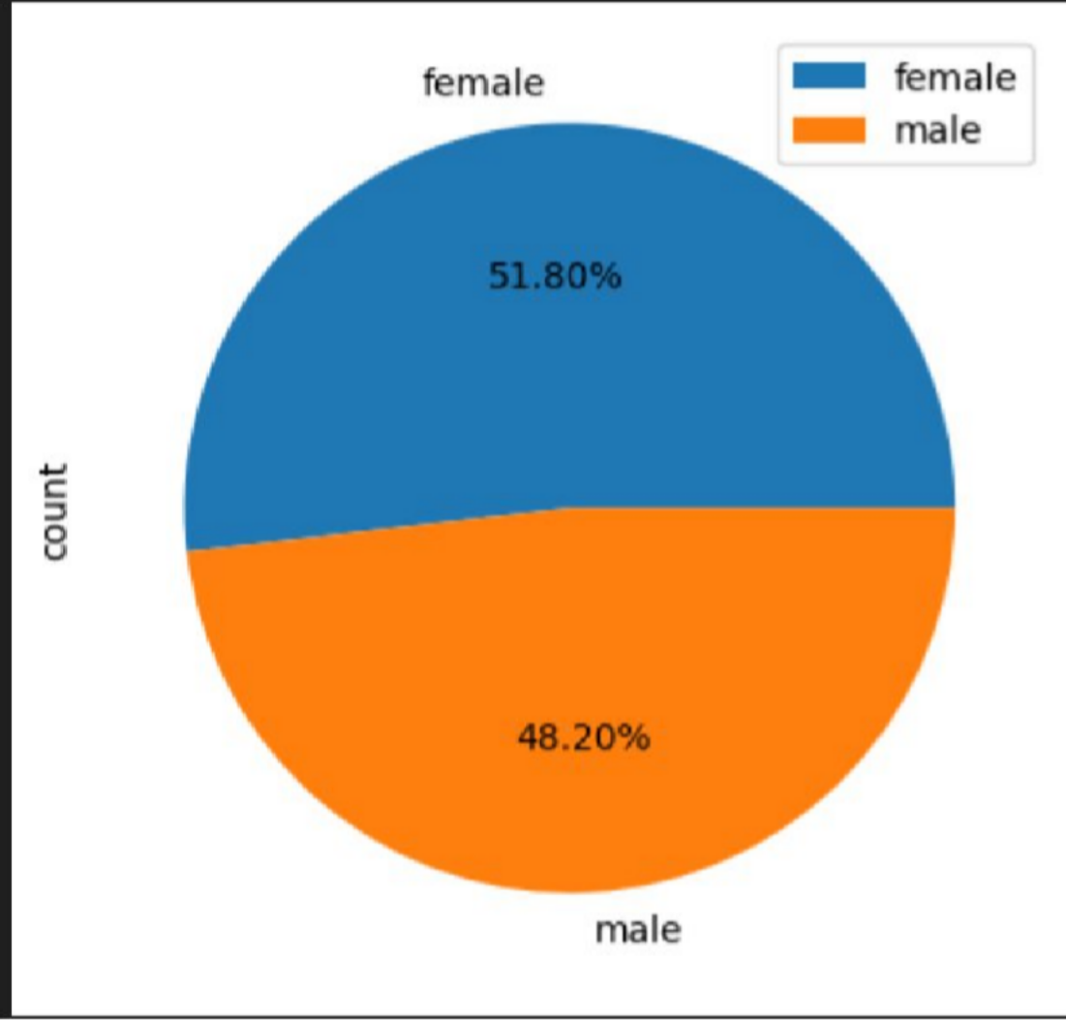
Gender-Based Performance Analysis
Overall Moderation
While specific subject areas might show minor gender-based score variations, the overall impact on global academic performance is found to be moderate. Gender is not a predominant factor in this dataset's performance metrics.

Slide 10




Key Insights Summary
Test Preparation is Key
Structured test preparation courses emerge as the most significant driver of enhanced academic performance.
Socio-Economic Influence
Family background and access to resources substantially impact student results, highlighting disparities.
Gender Differences are Secondary
While present, gender-based performance differences are not the dominant factor affecting overall academic success.
These data-driven insights offer valuable guidance for creating more effective and equitable educational policies. Understanding these core drivers allows educators and policymakers to allocate resources where they can have the greatest impact.

Slide 11

Conclusion & Future Perspectives
This exploratory data analysis project successfully uncovers critical drivers of academic performance, underscoring the vital roles of educational support and socio-economic considerations.
Future Work & Recommendations
Advanced Statistical Testing: Implement rigorous statistical tests to validate observed correlations and ensure causal inference.
Predictive Modeling: Develop models to forecast student performance, allowing for early intervention strategies.
Inclusion of New Variables: Integrate additional educational and psychological variables (e.g., teaching methods, student motivation) for a more holistic view.
Longitudinal Studies: Track student performance over time to understand developmental trends and long-term impacts of interventions.

Slide 12
Sources:
Kaggle:
https://www.kaggle.com/datasets/sadiajavedd/students-academic-performance-dataset

